Slide 1


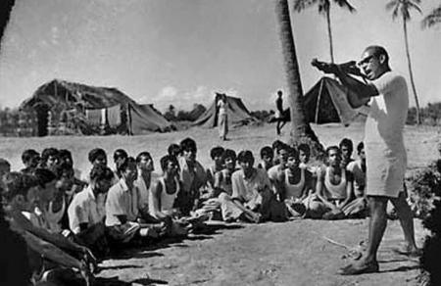

The role of
students in Liberation War

Slide 2

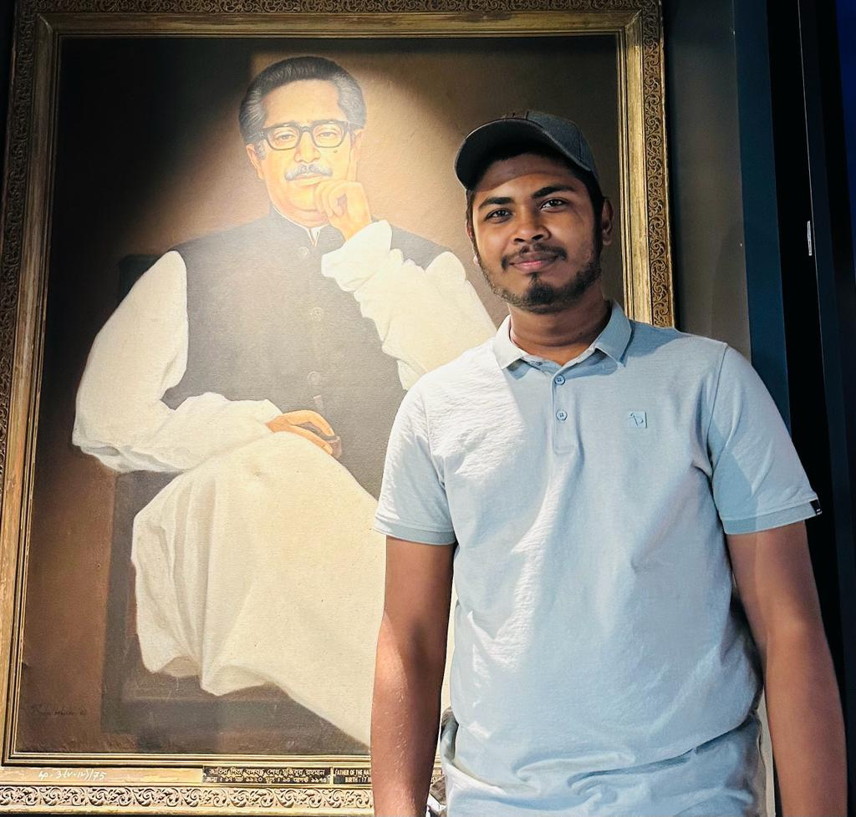
Presented by
Awadhe Hossain
ID:0112330487
Topic: Background

Slide 3



When was our liberation War started?
In 1971
In 1947
Disparity between East and West Pakistan

Slide 4
Actually
The seeds of independence were essentially sown
In 1952

Slide 5
Many movement
were occurred (1952-1971)
Language movement of 1952
Student movement of 1962
Mass uprising of 1969
Liberation War of 1971

Slide 6
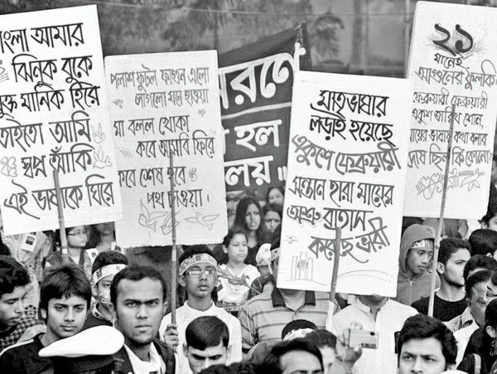
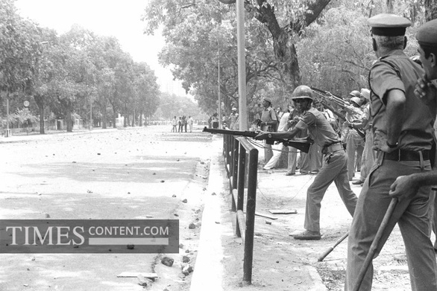
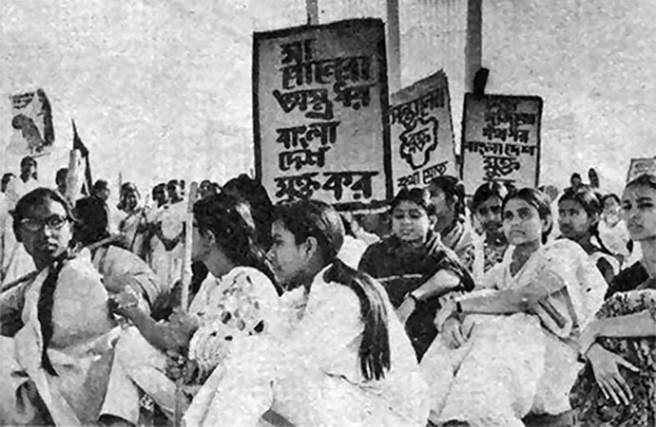
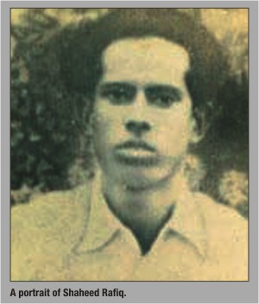
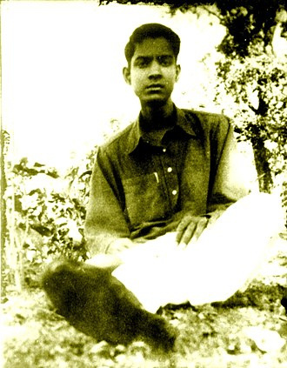
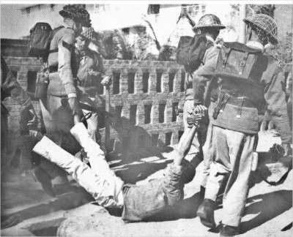
1952
Language Movement

Slide 7
1952
Language Movement

Slide 8
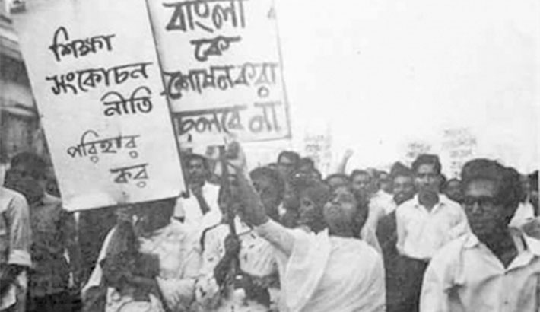
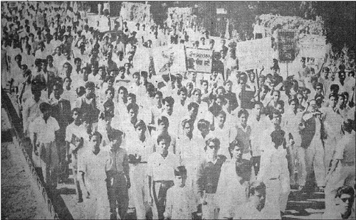
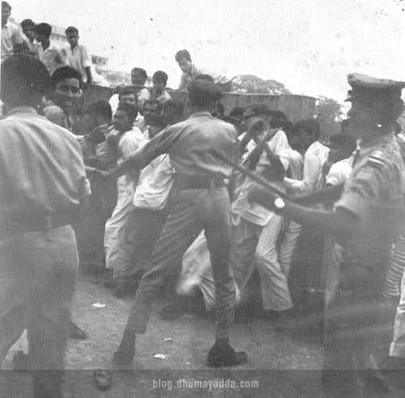
1962
Student Movement

Slide 9
1962
Student Movement

Slide 10
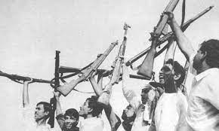
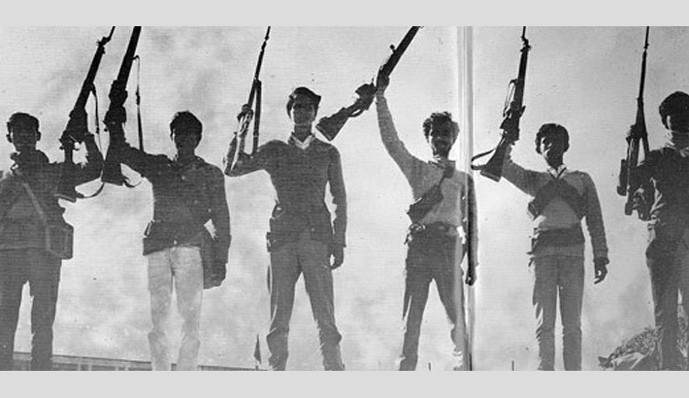
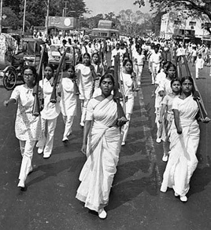
Libaration war of
1971

Slide 11
Libaration war of
1971

Slide 12

Presented by
S. M. Ali Ahadul
Hassan Himel
ID: 0112330074

Slide 13
Magnitude Steps of Students

Slide 14
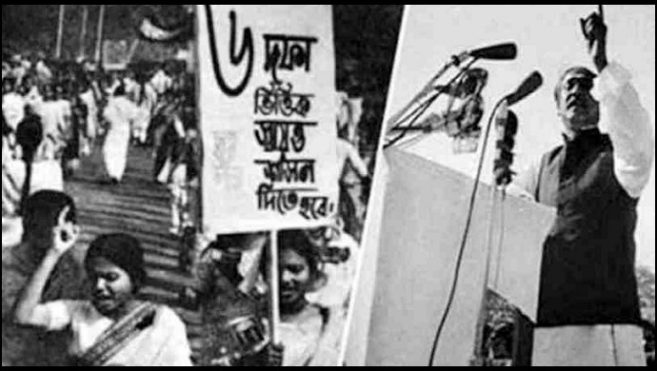
Six-Point Movement (1966)
Students actively supported the Six-Point Movement proposed by Sheikh Mujibur Rahman, which demanded autonomy for East Pakistan. The movement gained momentum with students taking part in rallies and demonstrations.

Slide 15
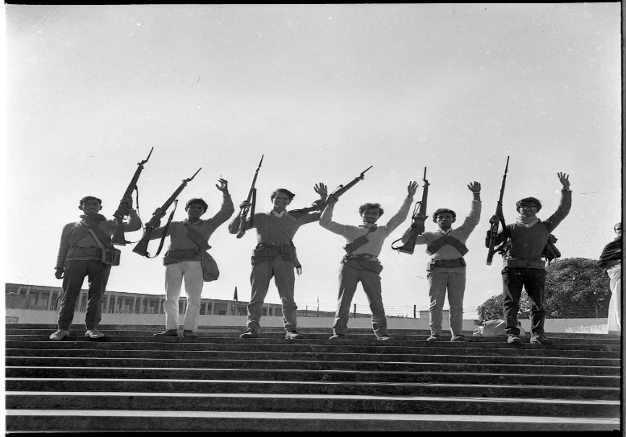
Formation of Mukti Bahini
(December 1971):
As the conflict escalated, students joined the Mukti Bahini, the Liberation Army formed by the Bangladesh government in exile. Many students took up arms and fought alongside the military against the Pakistani forces.

Slide 16
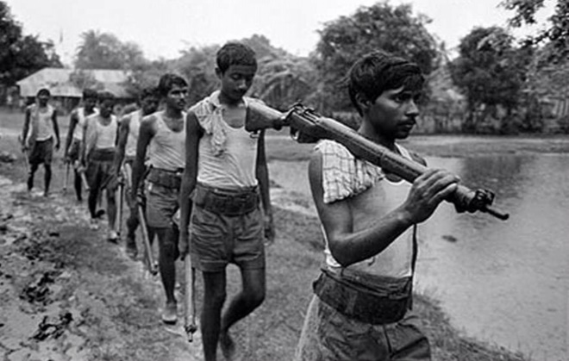
Role in Guerrilla Warfare:
Students played a significant role in guerrilla warfare, utilizing their knowledge of the local terrain to launch effective attacks against the better-equipped Pakistani military.

Slide 17

Presented by
Abu Huraira Shakil
ID: 0112330153

Slide 18
Reaction of
Pakistan

Slide 19
During the Bangladesh Liberation War in 1971, students played a crucial role in advocating for independence and resisting the oppressive actions of the Pakistani government. The students' active involvement in the movement drew a strong reaction from the Pakistani government, leading to severe consequences.
Here's an overview...

Slide 20
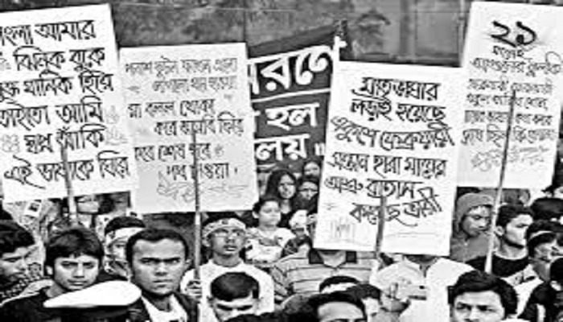
Student Involvement in Advocating Independence
Students in East Pakistan, now Bangladesh, were vocal advocates for autonomy and independence. They actively participated in protests, demonstrations, and other forms of peaceful resistance to express their support for the liberation of Bangladesh

Slide 21
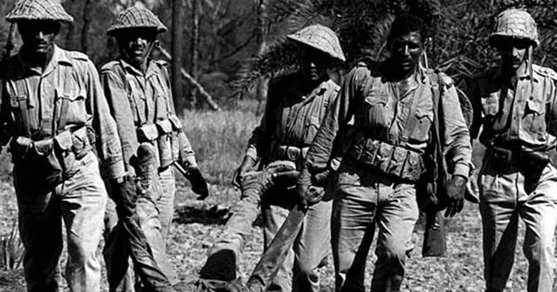
Pakistani Government's Crackdown on Students
In response to the students' involvement in the independence movement, the Pakistani government, under the leadership of General Yahya Khan, initiated a brutal crackdown on students and intellectuals. The government viewed students as a significant force behind the push for autonomy and independence, and thus, they became a target for suppression.

Slide 22
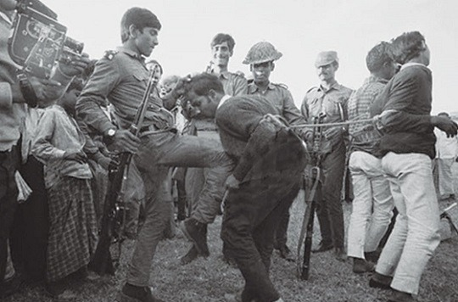
Arrests, Torture, and Executions
Students were specifically targeted by the military for their prominent role in the movement. Many students were arrested, subjected to torture, and, in some cases, executed for their involvement in advocating for the independence of Bangladesh.

Slide 23
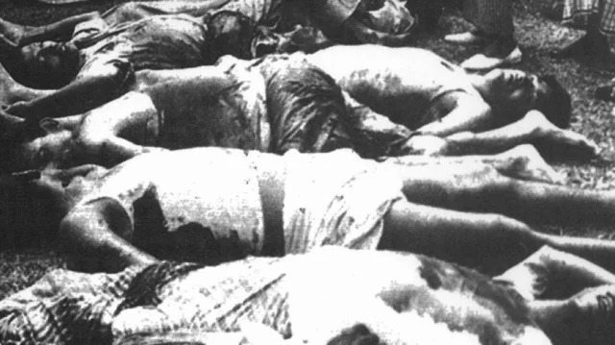
Dhaka University Massacre
One of the most infamous incidents occurred at Dhaka University on March 25, 1971. The Pakistani military carried out a brutal massacre on the university campus, targeting students and faculty members who were seen as supporters of independence.

Slide 24
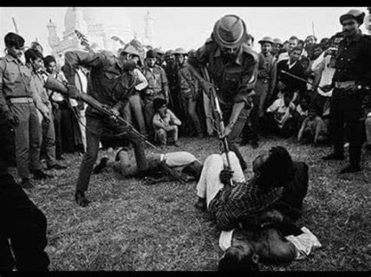
Forced Silence and Repression
The Pakistani government sought to suppress dissent by using force to silence student activists. This included shutting down universities and colleges, restricting freedom of speech, and curbing any form of organized resistance.

Slide 25
Censorship and Control of Educational Institutions
The government imposed strict control over educational institutions, censoring academic activities and limiting the dissemination of information that supported the independence movement.

Slide 26
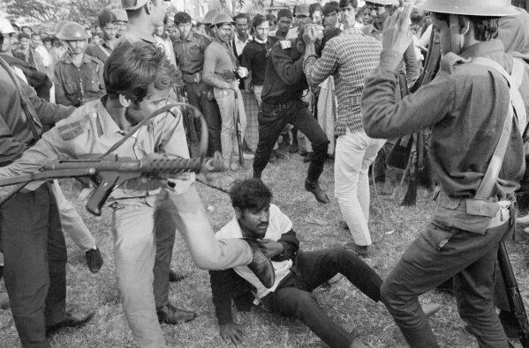
Attempt to Quell Resistance
The military's intention was to quell the resistance by eliminating key figures, including students, who were actively involved in the movement. This led to a widespread atmosphere of fear and intimidation.

Slide 27
The Pakistani government, faced with widespread student participation in the Bangladesh Liberation War, responded with a brutal crackdown, including arrests, torture, executions, and massacres. The government sought to suppress the students' role in the movement by any means necessary, resulting in a dark chapter in the history of the conflict.

Slide 28

Presented by
Samiur Rahman
Sameer
ID:0112330105

Slide 29
Repetition
of
Rejection

Slide 30
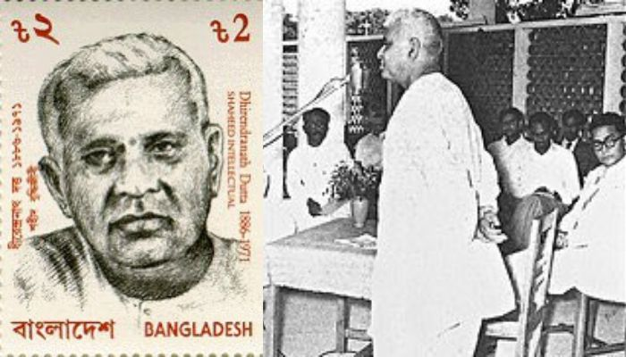
In 1948, Assembly member Dhirendranath Datta proposed legislation in the Constituent Assembly of Pakistan to allow members to speak in Bengali and authorize its use for official purposes.
But then Prime minister Liaquat Ali Khan and the Muslim League rejected and denounced the proposal as an attempt to divide the Pakistani people, thus the legislation was defeated.

Slide 31
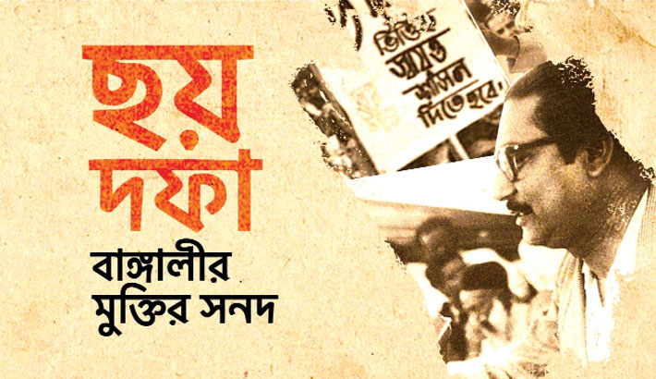
The six point movement was a movement in East Pakistan by
Sheikh Mujibur Rahman, which called for greater autonomy for East Pakistan. The movement's main agenda was to realize the six demands.

Slide 32
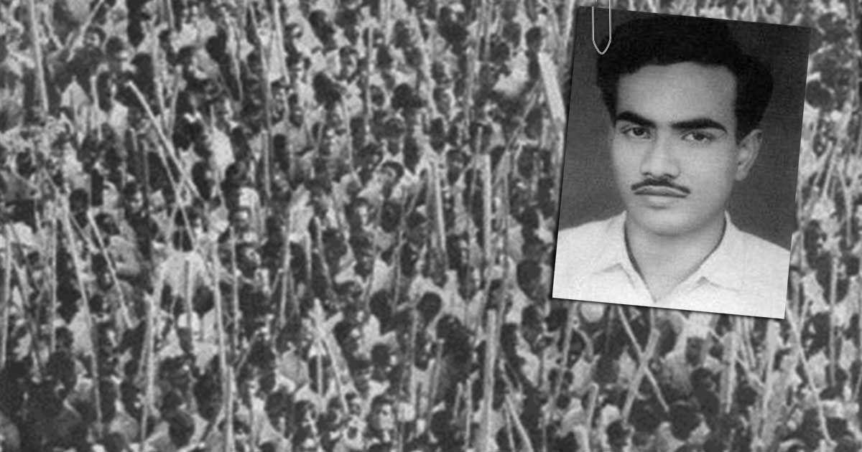
Although the proposal was rejected by the politicians from West Pakistan and the non Awami League politicians from East Pakistan. It was rejected by the president of the All Pakistan Awami League, Nawabzada Nasarullah Khan. The movement mainly had support from the majority of the population of East Pakistan.
Exactly 51 years ago, on January 20, 1969, the murder of a student leader by the police turned a large non-threatening student movement into a mass upsurge.
Its known as The Mass Spsurge of 69.

Slide 33
Presented by
Sabrina Akter
ID: 0112330606

Slide 34
Contribution of Students in the Liberation War of Bangladesh in 1971
The roles played by the students were:
Organizing protests and rallies
Joining Mukti Bahini
Joining the guerrilla force

Slide 35
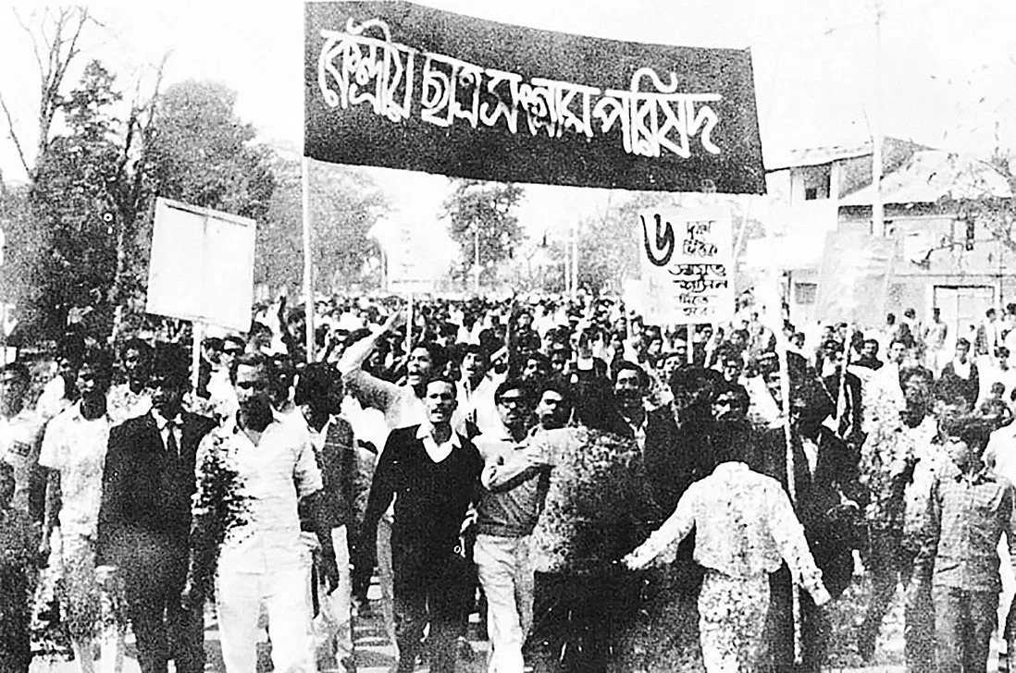
On March 1, 1971:
Protest Organized by Students

Slide 36
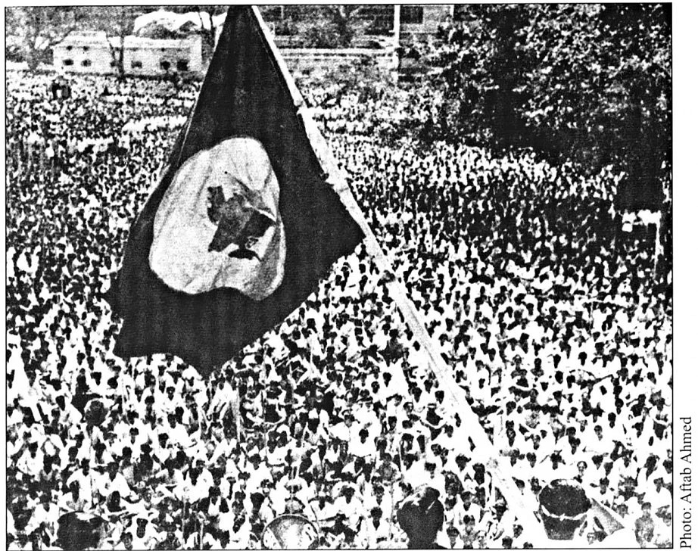
On March 2, 1971: The flag of Bangladesh was hoisted in the Arts Building of Dhaka University

Slide 37
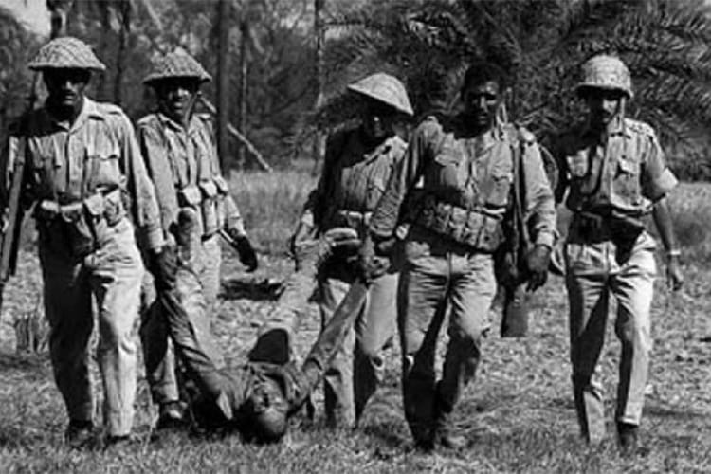
Since the students were the main source of Bengali Nation, the Pakistani Army launched Operation Searchlight on the university campus on 25 March 1971

Slide 38
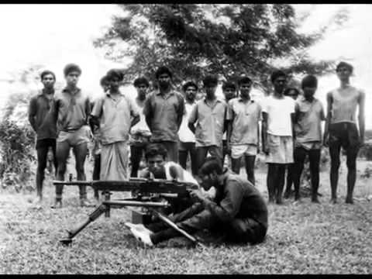
Students actively participated in Mukti Bahini, and formed guerrilla forces like “Crack Platoon”, ‘Mujib Battery’.
Crack Platoon operated many successful guerrilla operations in Dhaka city, showed exceptional courage during the war.

Slide 39

Presented By
Aftab Uddin Ahmad
ID 0112330382

Slide 40
Overview

Slide 41
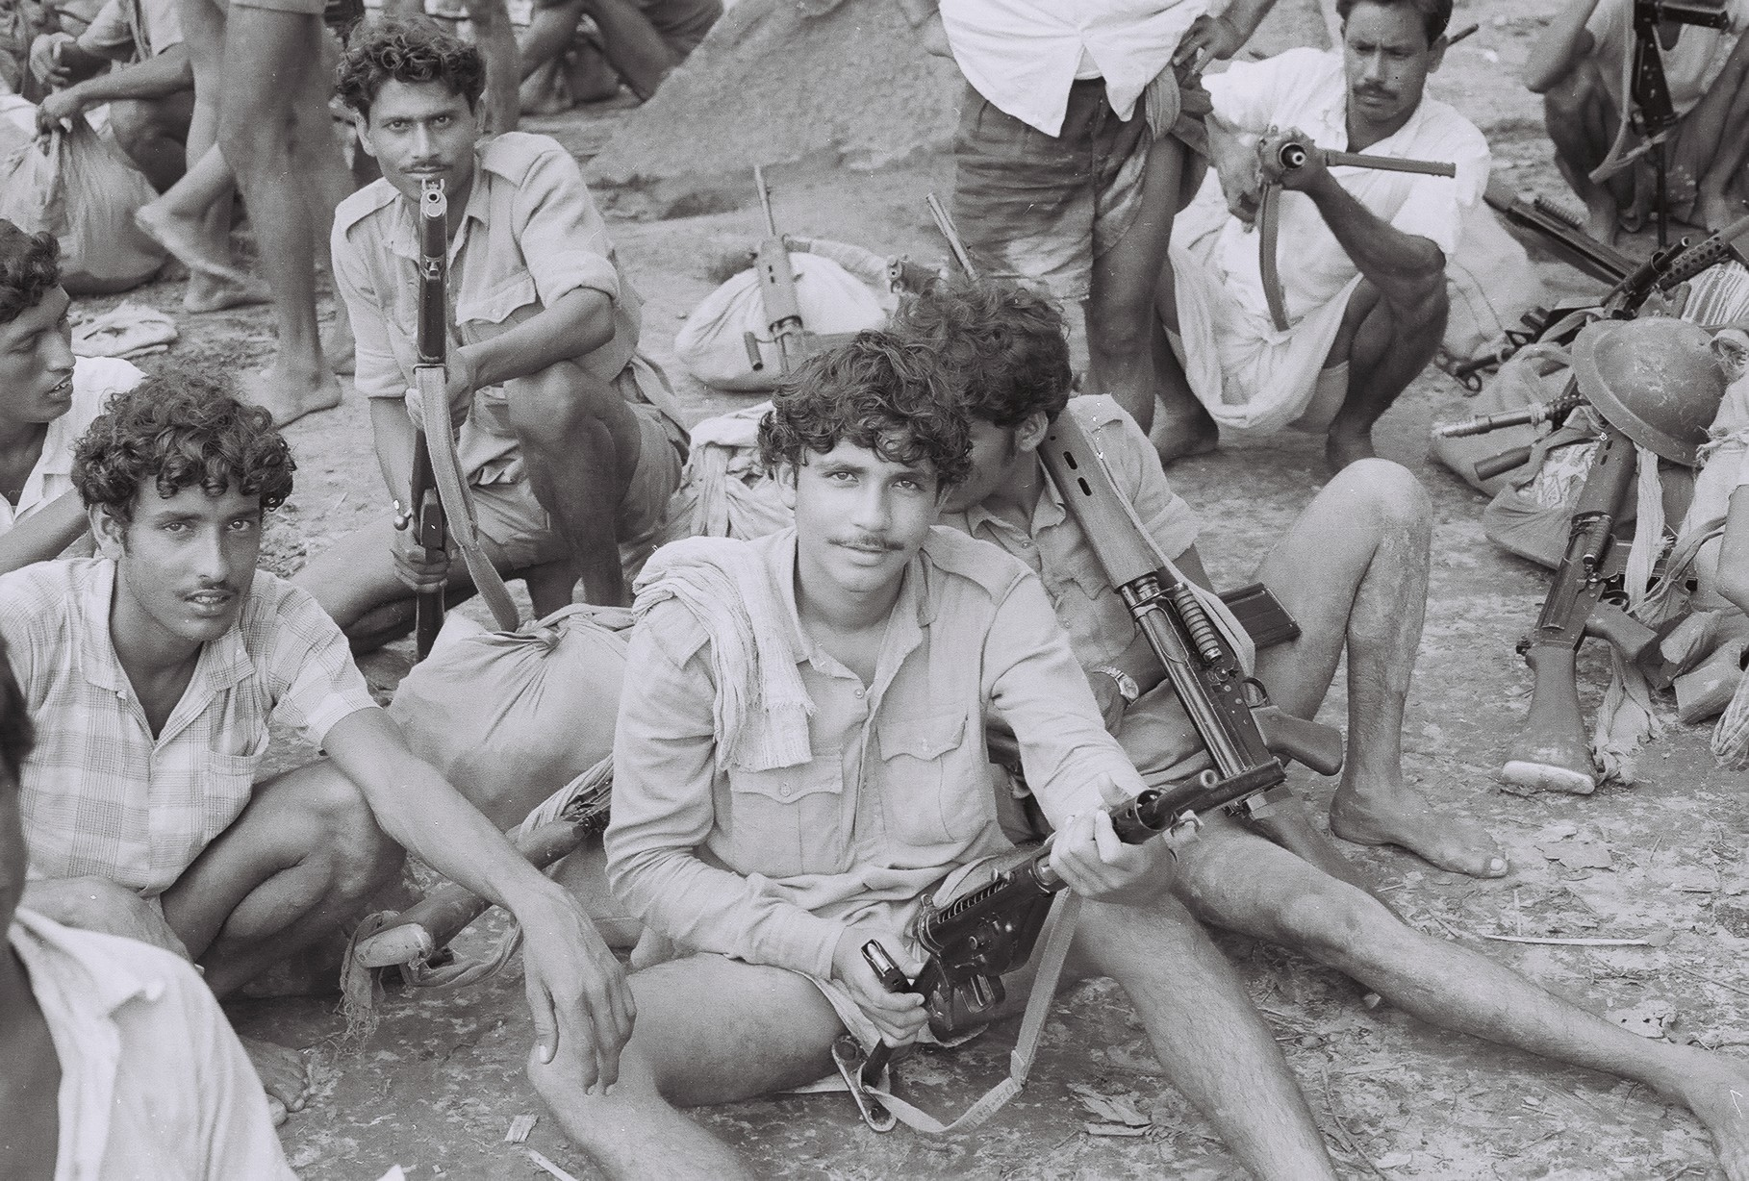
Symbol of Resistance
From the begining, night of 25th march students were the first attacker and defender which emphasizes us to the victory!

Slide 42
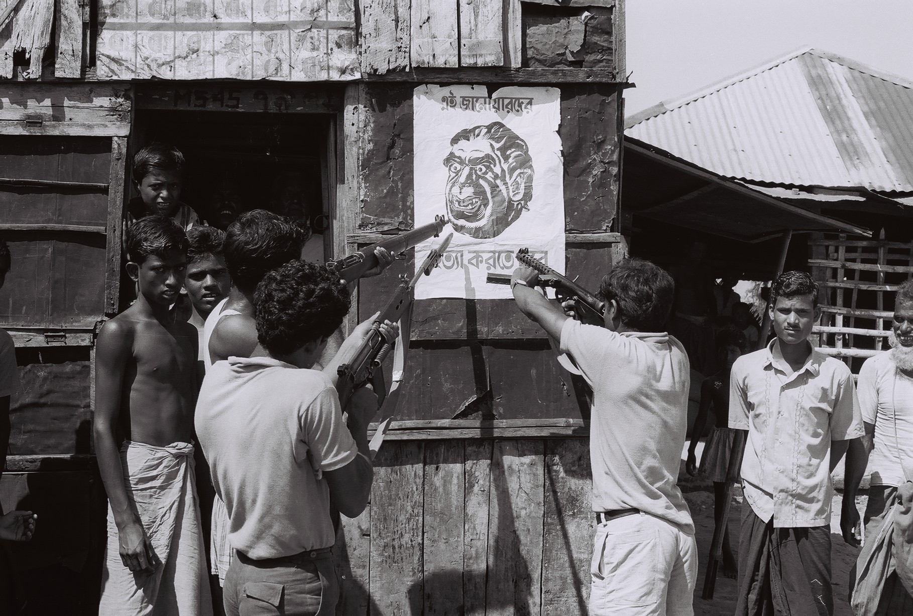
Mass Mobilizasion
Students organized various protests to the pakistani soliders that gave us the power to regenarate the believe in freedom!

Slide 43
For Example...
Non-cooperation Movement
Language Movement of 1952
Joined the Mukti Bahini
Joined the Liberation Army
Collaboration with Political Leaders
Declaration of Independence (March 26, 1971)

Slide 44
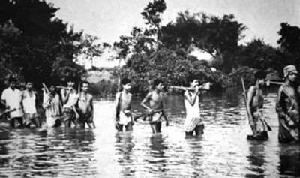
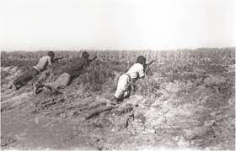
Active Advocacy
Students played a vital role in supplying essential information to the Bangladeshi resistance forces, aiding them in strategizing their assaults and military operations.

Slide 45
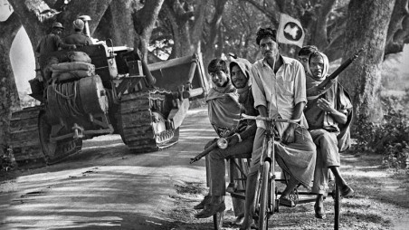
Humanitanian Efforts
Students were not only involved in the armed resistance but also engaged in humanitarian
efforts.

Slide 46
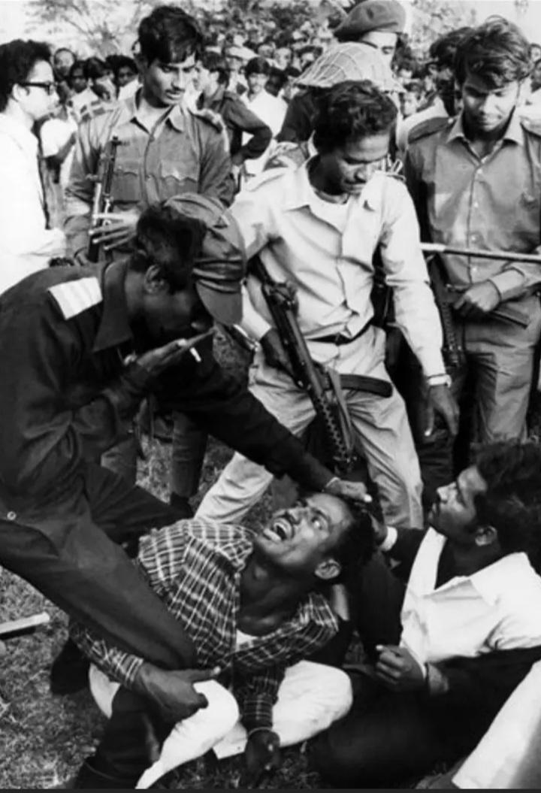
Sacrifices of students
Loss of Lives
Torture and Persecution
Loss of Normalcy
Separation from Families
Separation from Families
Moral and Emotional Damage

Slide 47
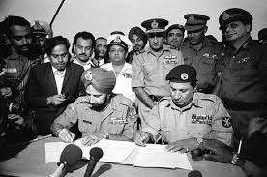
But after all of this sacrifices ,
we achieve our
INDEPENDENCE!

Slide 48
Conclusion

Slide 49
The students played a crucial role by providing vital intelligence, actively participating in armed resistance, and mobilizing mass support. Their resilience, marked by sacrifices in lives and disrupted academic pursuits, was instrumental in securing victory and establishing Bangladesh's independence on December 16, 1971. The enduring celebration of their leadership and commitment to justice highlights the profound significance of the students' contribution as a defining chapter in Bangladesh's history.

Slide 50
On that final note ,
I would like conclude
my presentation...

